Slide 1

CPE 490 Embedded Systems Lecture 17
FreeRTOS
Idle Task
Queues
Much of this presentation comes from www.freertos.org tutorial
As well as “Using the FreeRTOS Real Time Kernal, A Practical Guide”, Richard Barry, 2010 version 1.3.2.

Slide 2
Example Task Using Blocking State
void vTaskFunction( void *pvParameters ) {
char *pcTaskName;
pcTaskName = (char *) pvParameters;
for ( ; ; ) {
vPrintString( pcTaskName );
vTaskDelay( 250 / portTICK_RATE_MS );
}
}
Notes:
portTICK_RATE_MS is going to be the number of milliseconds in on clock tick. The delay will be for 250 ms. Therefore this task will be blocked for 250 ms.

Slide 3
Example Task Creation Using Blocking State
static const char *pcTextForTask1 = “Task 1 is running \r\n”;
static const char *pcTextForTask2 = “Task 2 is running \r\n”;
int main( void ) {
xTaskCreate( vTaskFunction, “TSK 1”, 1000, (void*) pcTestForTask1, 1, null);
xTaskCreate( vTaskFunction, “TSK 2”, 1000, (void*) pcTestForTask2, 2, null);
vTaskStartScheduler();
for( ; ; );
}
Notes:
In this case we made two instances of the task. Task 1 has a priority of 1 while Task 2 has a priority of 2. If the delay was not done by blocking task 1 would never run because task 2 would starve it. But since task 2 can now be blocked this opens time for task1 to run and since both tasks can be blocked the idle task will also run.

Slide 4
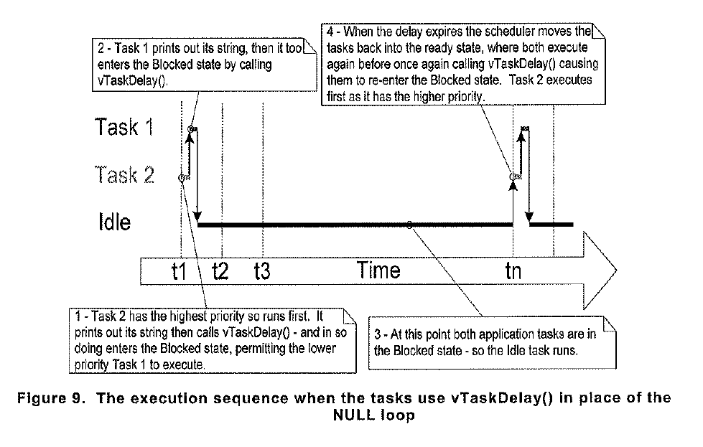
Timing Diagram

Slide 5
Idle Task
As can be seen from the last example the processor can spend a large amount of time in the Idle Task
What could be done during this time?
Gather information on the utilization of the processor
Execute low priority continuous background tasks
Save energy by putting the processor in a low power mode.

Slide 6
Idle Task Facts
Idle task is automatically created when vTaskStartScheduler() is called. Reason: you must have a task to run at all times
Idle task has a priority of 0
Nothing stopping you from making other tasks of this priority 0 BUT a Idle Task Hook Function is provided for that will allow you to write custom code.

Slide 7
Idle Task Hook Function
The Idle Task will call a user supplied function to accomplish application specific functions
To turn this feature on you must set the defined constant configUSE_IDLE_HOOK to be a value of 1
The idle task hook function will be called automatically by the idle task once per iteration of the idle task loop.
Notes:
Configuration variables are found in freeRTOSConfig.h

Slide 8
Rules for Idle Task Hook Function
Must never attempt to block or suspend or it could cause the a scenario where no tasks are available to enter the running state
If the idle task hook function call vTaskDelete() API function, then the idle task hook must always return to its caller within a reasonable time.
Notes:
The idle task performs clean up duty for the kernel resources after a delete occurs and therefore must run.

Slide 9
Prototype for Idle Task Hook Function
void vApplicationIdleHook ( void);
The name of the function must match this prototype name.
Since there is no passing in or out of the function global variables will need to be used to communicate values

Slide 10
Idle Task Hook Example
/* Declare a variable that will be incremented by the hook function */
unsigned long ulIdleCycleCount = 0;
Void vApplicationIdleHook( void)
{
/* This hook function does nothing but increment a counter */
ulIdleCycleCount++;
}

Slide 11
Idle Task Hook Example (cont)
void vTaskFunction( void *pvParameters )
{
char *pcTaskName;
pcTaskName = (char *) pvParameters;
for ( ;; ) {
vPrintStringand Number( pcTaskName, UlIdleCycleCount);
vTaskDelay(250/ portTICK_RATE_MS );
}
}

Slide 12
Example Task Creation Using Blocking State
static const char *pcTextForTask1 = “Task 1 is running \r\n”;
static const char *pcTextForTask2 = “Task 2 is running \r\n”;
int main( void ) {
xTaskCreate( vTaskFunction, “TSK 1”, 1000, (void*) pcTestForTask1, 1, null);
xTaskCreate( vTaskFunction, “TSK 2”, 1000, (void*) pcTestForTask2, 2, null);
vTaskStartScheduler();
for( ; ; );
}
Notes:
In this case we made two instances of the task. Task 1 has a priority of 1 while Task 2 has a priority of 2. If the delay was not done by blocking task 1 would never run because task 2 would starve it. But since task 2 can now be blocked this opens time for task1 to run and since both tasks can be blocked the idle task will also run.

Slide 13
Example output w/ Idle Task Hook
Task 2 is running
ulIdleCycleCount = 0
Task 1 is running
ulIdleCycleCount =0
Task 2 is running
ulIdleCycleCount =3869504
Task 1 is running
ulIdleCycleCount =3869504

Slide 14
The Queue in FreeRTOS
Each task can be thought of as a mini program
How can one program get information to another?
How can tasks synchronize upon events including events driven by processing data
A queue can be created that will allow information to be shared

Slide 15
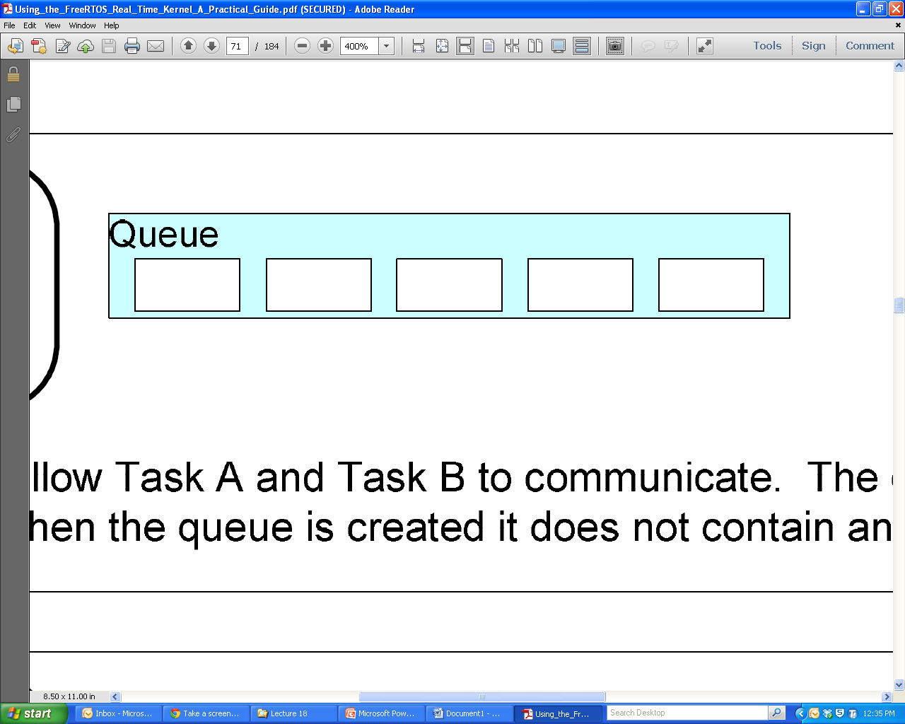
Characteristics of a Queue
A holds a finite number of fixed sized data items
The Length of a queue is the max number of items it can hold
Normally queues are First in First Out (FIFO) buffers
Out
In

Slide 16
Queues as Objects
A queue is its own object not owned by the creator of the task
Multiple writers and readers of the queue are possible
A queue having multiple writers is common, multiple readers is rare.

Slide 17
Blocking on Queue Reads and Writes
If a task wants to read from the queue but the data has not been written yet, the task can block itself until the queue has been written to.
If a task wants to write to the queue but the queue’s length has been reached then a task can block itself waiting for a queue read by another task to occur.
In both cases a task can specify a max amount of time to wait.
Notes:
Multiple readers or writers can be waiting for a read or write to occur only the highest priority task will be unblocked when that occurs. If at the same priority the one that has been waiting the longest will be unblocked.

Slide 18
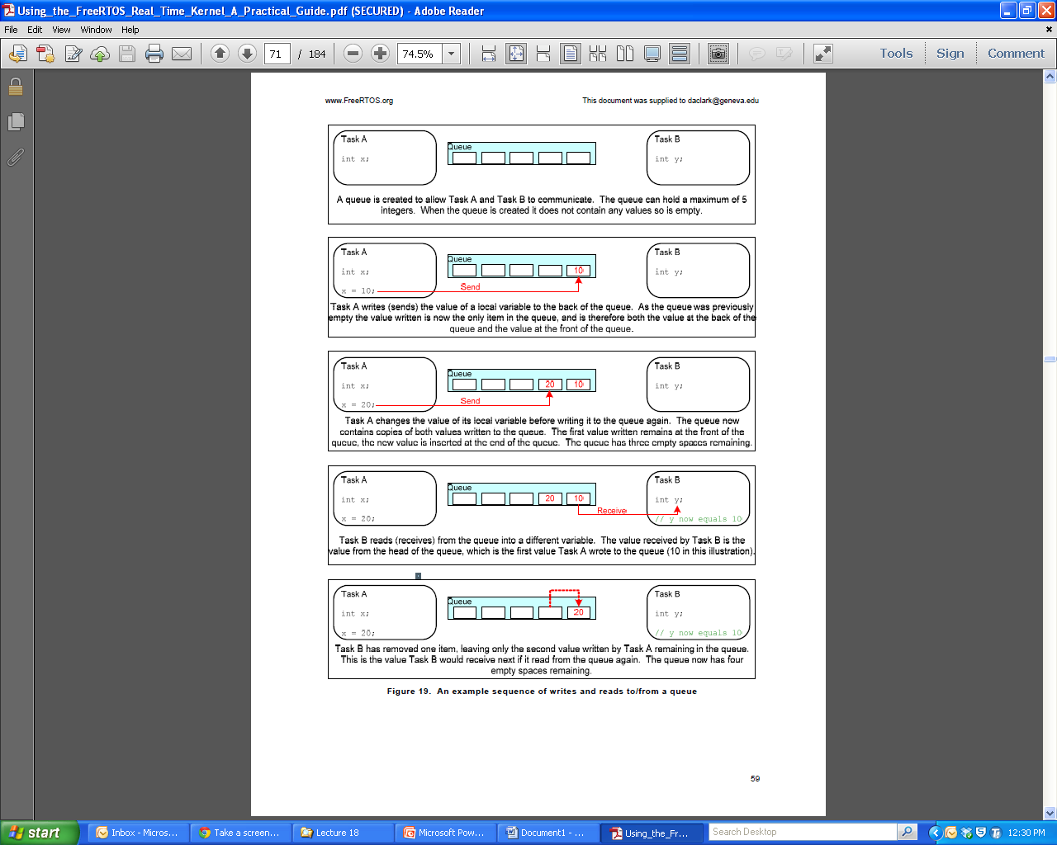

Slide 20
Creating a Queue
Prototype
xQueueHandle xQueueCreate(
unsigned portBASE_TYPE uxQueueLength,
unsigned portBASE_TYPE uxItemSize);
uxQueueLength: The max number of items in queue
uxItemSize: The size in bytes of each data item
Return: if Null then not created, otherwise a handle to describe the queue

Slide 21
Writing the Queue
Prototype:
portBASE_TYPE xQueueSendToFront(
xQueueHandle xQueue, //describes the unique queue
const void * pvItemToQueue,//points to data to store
portTickType xTicksToWait); //how long to wait for a free //spot if the queue is full
portBASE_TYPE xQueueSendToBack(
xQueueHandle xQueue,
const void * pvItemToQueue,
portTickType xTicksToWait);
Notes:
The next read will always be at the front of queue.
The const void * pointer: const is an indication that the API function can not modify the value pointed at.
If xTicksToWait is set equal to portMAX_DELAY will cause wait to be indefinite, if 0 then it will return without blocking the calling thread.

Slide 22
Writing- the Queue Return Value
Return value of pdPASS can mean either
Data was successfully sent to the queue OR,
If xTicksToWait was not zero then room in the queue was available before the wait time expired
Return value of errQUEUE_FULL can mean either
Data could not be written because the queue is full OR,
If xTicksToWait was not zero then room in the queue was not available before the wait time expired

Slide 23
Read vs Peek
When the queue is read then the value that is read is removed from the queue
When the queue is peeked at the read value is not removed from the queue

Slide 24
Reading and Peeking into the Queue
Prototypes
portBASE_TYPE xQueueReceive(
xQueueHandle xQueue, // uniquely identifies queue
const void * pvBuffer, // pointer to memory place data
portTickType xTicksToWait); // how long to wait for an //anoter task to write to //the queue
portBASE_TYPE xQueuePeek(xQueueHandle xQueue,
const void * pvBuffer, portTickType xTicksToWait);
Notes:
The receive function will permanently remove data from the front of the queue.
The peek function will only get the value but not remove it
PVBuffer is a pointer to the memory into which the received data will be copied.

Slide 25
Reading- the Queue Return Value
Return value of pdPASS can mean either
Data was successfully read from the queue OR,
If xTicksToWait was not zero then a value was written to the queue before the wait time expired
Return value of errQUEUE_FULL can mean either
Data could not be read because the queue is empty OR,
If xTicksToWait was not zero then nothing was written to the queue before the wait time expired

Slide 26
Other Related Queue API
Prototype
unsigned portBASE_TYPE uxQueueMessagesWaitin(
xQueueHandle xQueue); // This function is used to
//query the number of items that are currently in
//the queue. The returned value is that number.
Important note: most queue API function calls can not be made inside an interrupt, special API functions are to be used.

Slide 27
The Yield Task
Prototype: void taskYIELD( void);
Yield to another task of equal priority.
This allows a task to yield with out waiting for the next time tick to preemptively change tasks
If no other tasks at equal priority then the calling task gets the processor again.

Slide 28
Example of using a Queue
This example will have two tasks writing to the queue and one task reading the queue.
The task reading the queue will have a higher priority then those writing
Therefore the queue should never have more than one piece of data
The writing tasks will use the API taskYIELD() to relinquish the current task but not to block

Slide 29
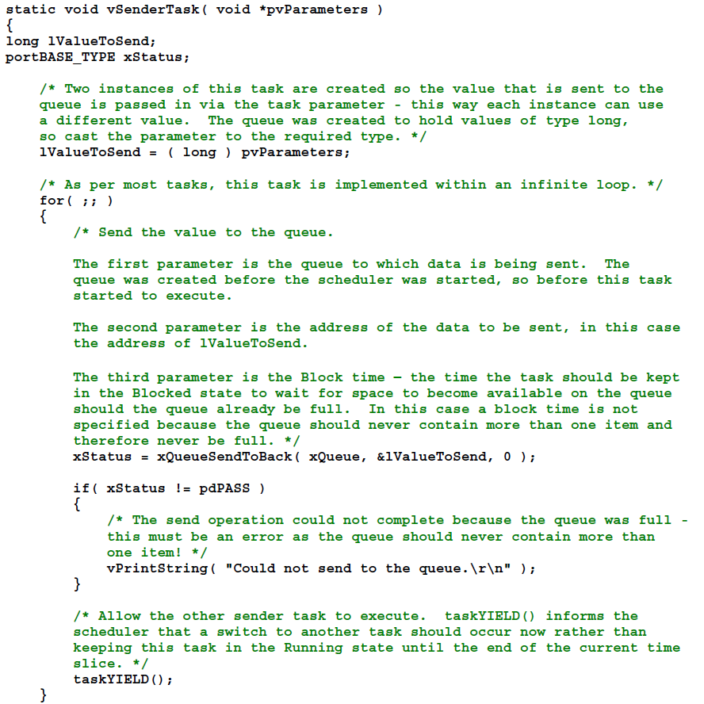
Task to write to Queue
Should be:
*(long *) pvParameters;
No waiting time
Relinquish with out blocking
Notes:
Functions that are visible only to other functions in the same file are known as static functions.

Slide 30
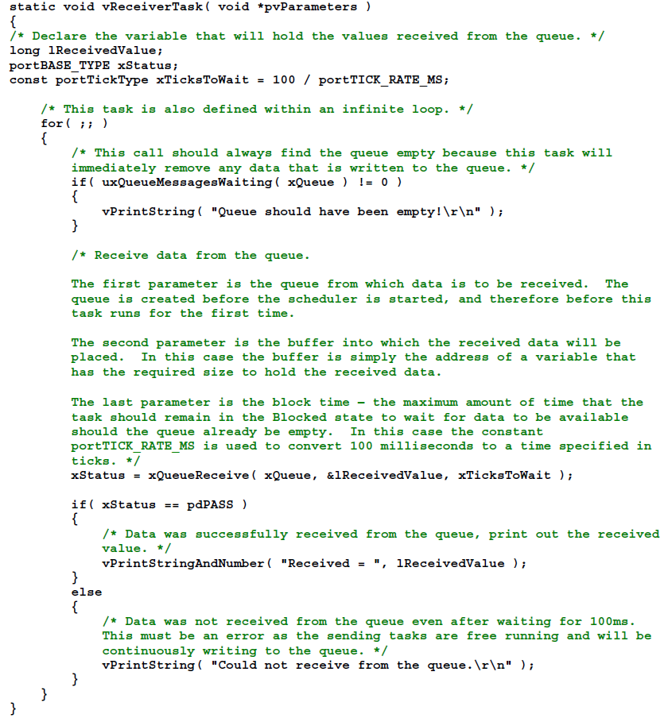
Task to Read Queue

Slide 31
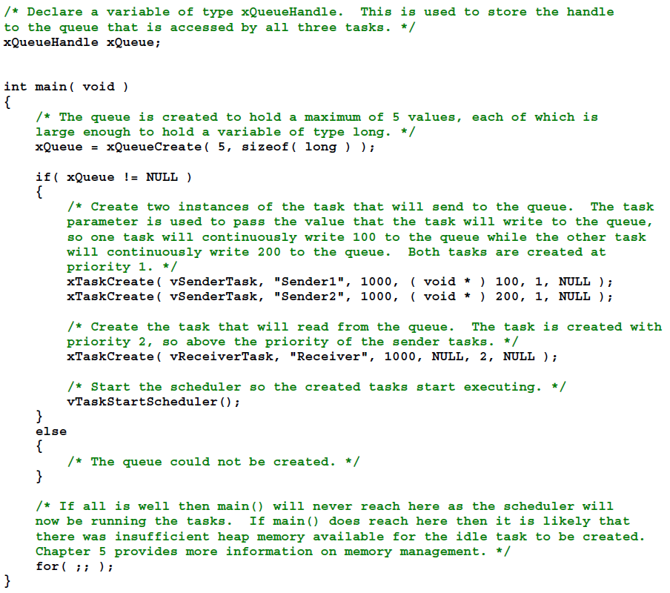
Create Queue and Tasks
Create Queue
Reading of task is greater priority than writing

Slide 32
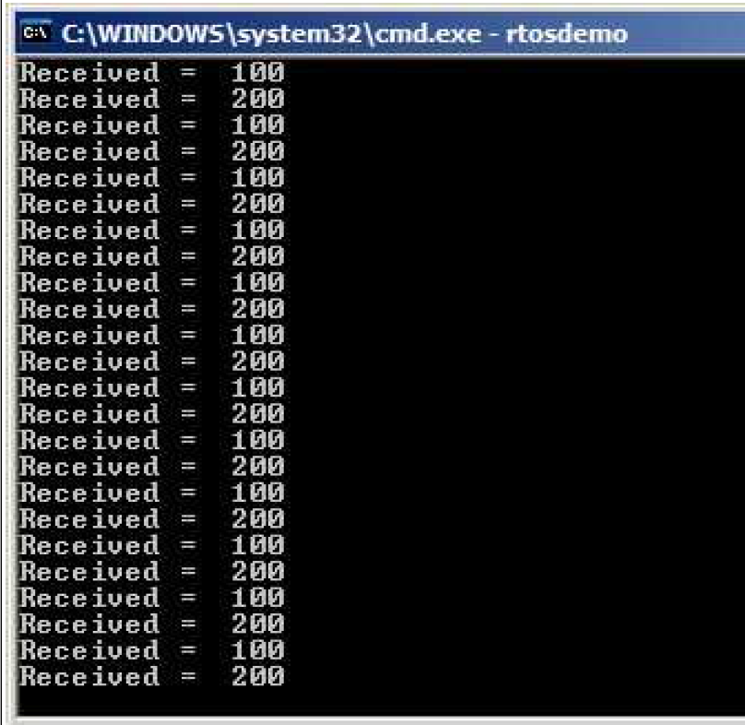
Screen Output of Example

Slide 33
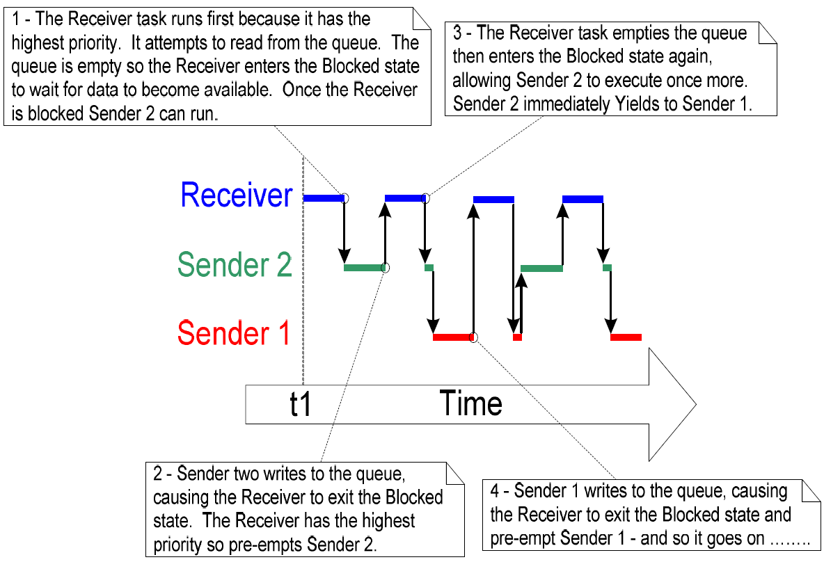
Example Sequence

